Slide 1

Chess Game
OOP Python Application
A two-player CLI & GUI chess game
Developer: Eyal Grinberg

Slide 2
Motivation & Problem Statement
Goal - Build a complete chess game application with:
Accurate move validation and rule enforcement
Interactive GUI and testable CLI
Have fun
Motivation:
Practice end-to-end software engineering from backend to UI
Apply OOP and system design principles in a real-world game

Slide 3
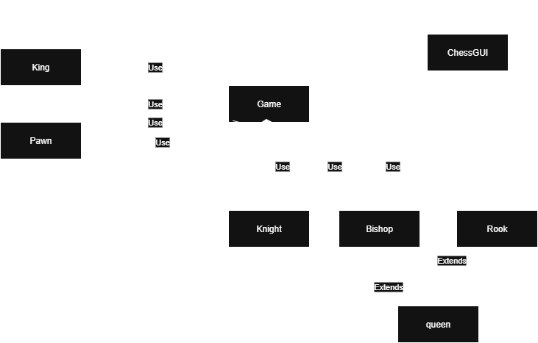
Architecture

Slide 4
Features
CLI version for logic testing and debugging – including a testing function
GUI version using Tkinter: interactive board, status updates, additional action buttons
Move validation based on simulations (check, mate, stalemate detection, castling logic, pins, etc.)
Error handling and informative exceptions usage
Data flow separates UI from logic for modularity

Slide 5
Data Flow
Game & board initialization
User input
(via GUI)
“regular move”
Special action
button
Parse controller input to a CLI input
GUI.handle_click()
Reset Game, Resign, Offer Draw
Try playing a move
game.move_piece() + game.check_king_threat()
If none of the conditions were met
legal move
illegal move
The move ended
with a check?
Raise exception & retry
yes
no
game.test_mate()
Check draw conditions:
50-move rule
Insufficient material draw
3-fold repetition
stalemate

Slide 6
Challenges
Designing testable components while building interactively
Complex game logic algorithms without relying on external libraries or tools
Building without code assistants or internet access at times

Slide 7
Results & Future work
Outcomes:
Fully working chess game: all rules supported
CLI and GUI modes for flexibility
Clear architecture and testability
Future Features
Evaluation bar
AI opponent (RL)

Slide 8
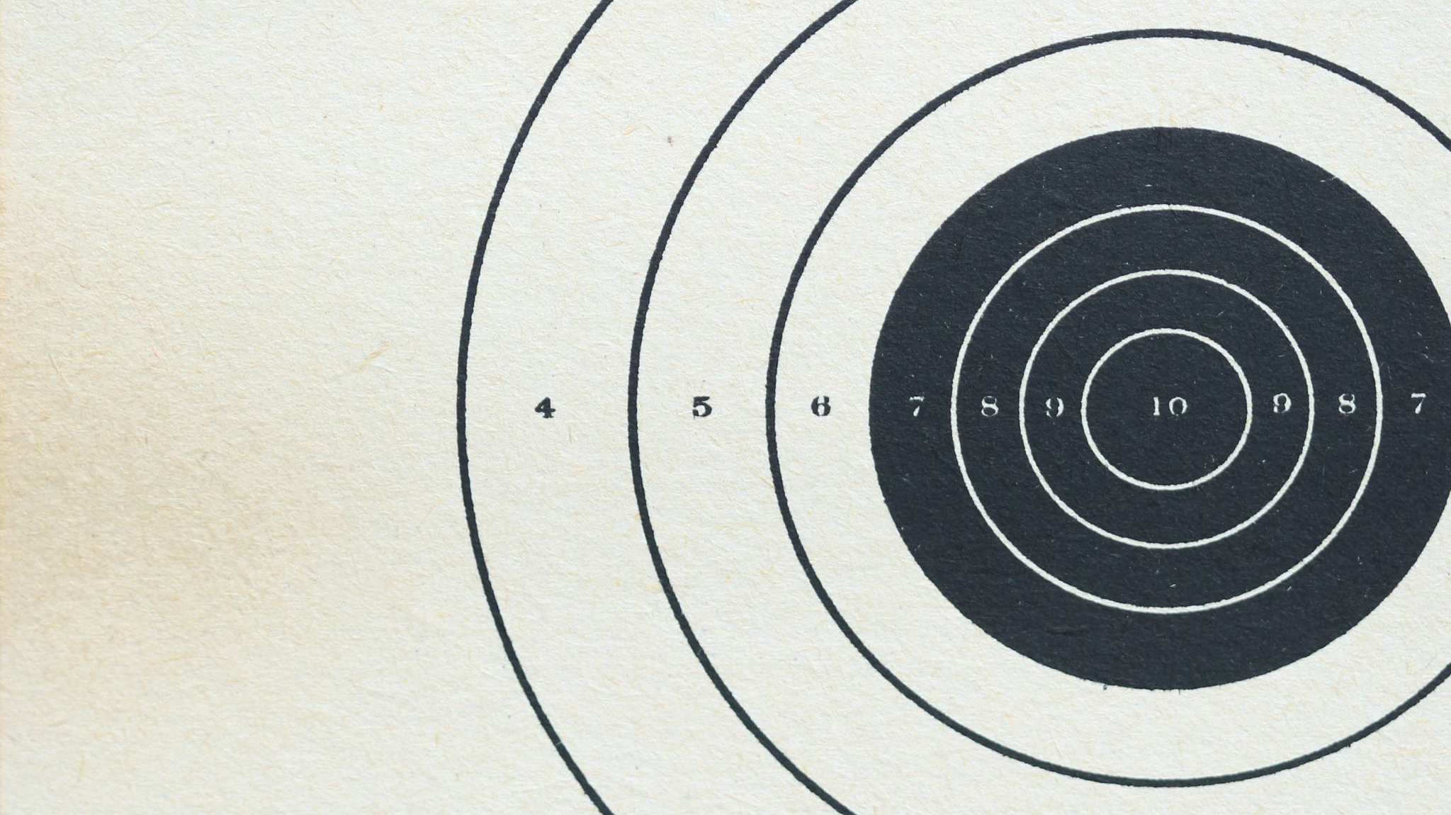
Demo

